Slide 2
Reconsidering Strongly Typed Programming for the Information-Rich World
16 July, 2012
Don Syme
Principal Researcher, Microsoft Research

Slide 3

F# and Open Source
F# 2.0 compiler+library open source
http://github.com/fsharp/fsharp
Apache 2.0 license
Runs on Mac, Linux, Windows, Browsers
Free Open-Source IDE Tooling with MonoDevelop
F# 3.0 open source in preparation

Slide 4
Part 0 A quick retrospective

Slide 5
Time Warp…
1992
…
2012

Slide 6
1998 to 2010…
C# LINQ
SIGMOD2006
C# 3.0 Spec
F# Metaprog
ML 2006
F# 1.0
.NET Generics
PLDI 2001
POPL 2004
ECMA 2005
C#/VB Generics
PLDI 2001
C# 2.0
ECMA 2005
F# Active Patterns
ICFP 2007
.NET CLI
2.0-4.0
C#/VB
1.0-5.0
F#
2.0
F# Core Lang
ML 2004
F# 1.0
F# Async/Parallel/
Agents
F# 2.0
PADL 2010
.NET 4.0 Tasks
OOPSLA ‘09
C# Async
C# 5.0
F# Units of
Measure
POPL 2009
F# 2.0
Notes:
.NET 2.0-4.0, C# 2.0-4.0: .NET Generics: deep innovation, heavily inspired by functional programming design & implementation, deeply empowering for C#/VB programmers. Generic programming, with total simplicity, with debugging, with runtime types, with unboxed efficiency, with precompilation. Assert this has put Microsoft 10-20 years ahead in this aspect of VM implementation: there is still no sign of JVM or other implementations or designs that rival the CLR on this design point. IMHO anyone who builds a typed VM language on anything less is building on sand.
C# 3.0-4.0: Lambda Expressions, LINQ. I had less to do with this, but it is fundamentally enabled by .NET generics. It is a wonderful and ground-breaking embedding of queries into languages
F# 2.0: Strongly typed functional programming for .NET, built on .NET Generics
F# 2.0: Units of Measure with effective type inference. Again, it feels Microsoft is 10-20 years ahead of the competition for this feature. Take that as a challenge, if you like.
F# 2.0: Asynchronous + parallel + agent programming. Smoothly integrated asynchronous programming and agents on a VM through local CPS rewriting. Similar to Kilim, predates it a little (2007).
C# 5.0: Look for a sneak preview next week!

Slide 7
1998 to 2010…
The dark days of object fundamentalism are past us ☺
Mixed OO/FP languages are now industry standard
(C#, C++, VB, Java, Javascript, Scala, F#, …)
Microsoft and MSR have been instrumental in this transformation

Slide 8
Part 1 Introducing F# and F# 3.0

Slide 9
Today’s talk is very simple

Slide 10
Proposition 1 The world is information-rich

Slide 11
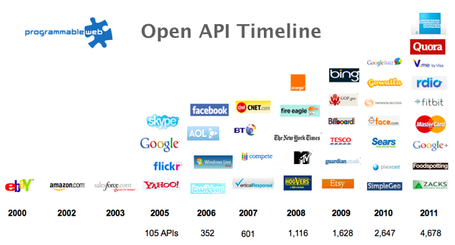
The Information Revolution

Slide 12
Proposition 2 Our languages are information-sparse

Slide 13
Proposition 3 This is a big problem (especially for strongly typed languages)

Slide 14
Proposition 4 F# 3.0 starts to fix this

Slide 15
Today (1) Demonstrate F# 3.0 (2) Themes in Information Rich Programming

Slide 16
Paradigm Locator
Statically Typed
Dynamically Typed

Slide 17
Paradigm Locator
Statically Typed
Dynamically Typed
A major search is on!
make statically typed langs more dynamic
make dynamically typed langs more static
moderate static typing in limited ways

Slide 18
But first, F# 1.0/2.0… (Visual Studio 2008 & 2010)

Slide 19
F# is…
...a productive, supported, interoperable, functional language that allows you to write simple code to solve complex problems.

Slide 20
F#
C#
let swap (x, y) = (y, x)
let rotations (x, y, z) =
[ (x, y, z);
(z, x, y);
(y, z, x) ]
let reduce f (x, y, z) =
f x + f y + f z
Tuple<U,T> Swap<T,U>(Tuple<T,U> t)
{
return new Tuple<U,T>(t.Item2, t.Item1)
}
ReadOnlyCollection<Tuple<T,T,T>> Rotations<T>(Tuple<T,T,T> t)
{
new ReadOnlyCollection<int>
(new Tuple<T,T,T>[]
{new Tuple<T,T,T>(t.Item1,t.Item2,t.Item3);
new Tuple<T,T,T>(t.Item3,t.Item1,t.Item2);
new Tuple<T,T,T>(t.Item2,t.Item3,t.Item1); });
}
int Reduce<T>(Func<T,int> f,Tuple<T,T,T> t)
{
return f(t.Item1)+f(t.Item2)+f(t.Item3);
}

Slide 21
Example (power company)
I have written an application to balance the national power generation schedule for a portfolio of power stations to a trading position for an energy company. ...the calculation engine was written in F#.
The use of F# to address the complexity at the heart of this application clearly demonstrates a sweet spot for the language within enterprise software, namely algorithmically complex analysis of large data sets.
Simon Cousins (power company)

Slide 22
language taster
Notes:
If you would like to host your demo on the Virtual Server, please use the myVPC demo slide, not this slide.

Slide 23
Fundamentals - Whitespace Matters
let computeDerivative f x =
let p1 = f (x - 0.05)
let p2 = f (x + 0.05)
(p2 – p1) / 0.1
Offside (bad indentation)

Slide 24
Fundamentals - Whitespace Matters
let computeDerivative f x =
let p1 = f (x - 0.05)
let p2 = f (x + 0.05)
(p2 – p1) / 0.1

Slide 25
F# - Objects + Functional
type Vector2D (dx:double, dy:double) =
let d2 = dx*dx+dy*dy
member v.DX = dx
member v.DY = dy
member v.Length = sqrt d2
member v.Scale(k) = Vector2D (dx*k,dy*k)
Inputs to object
construction
Object internals
Exported properties
Exported method

Slide 26
Fundamentals - Queries
let avatarTitles =
query { for t in netflix.Titles do
where (t.Name.Contains "Avatar")
select t }
LINQ Queries

Slide 27
Now, F# 3.0… (now available from www.fsharp.net!)

Slide 28
A Challenge! Task #1: A Chemistry Elements Class Library Task #2: A Biology Class Library Task #3: Repeat for all fields of human knowledge and endeavour…

Slide 29
Language Integrated Web Data
demo

Slide 30
Exploring Your World with Language Integrated World Bank Data
demo

Slide 31
F# Data Scripting for Hadoop and Hive
demo

Slide 32
A Type Provider is…. “Just like a library” “A design-time component that computes a space of types and methods…” “An adaptor between data/services and the .NET type system…” “Staged, on-demand type macros…”

Slide 33
Note: Language still contains no data Open architecture You can write your own type provider

Slide 34
Part 1 – Summary At MSR our job is to take languages forward F# 1.0-2.0 focused on FP+OO+Parallel+Units F# 3.0 focuses on information integration

Slide 35
Part 2 Themes in Information Rich Programming

Slide 36
Recap: the problem…
Languages do not integrate information
Non-intuitive
Not simple
Disorganised
Static
High friction

Slide 37
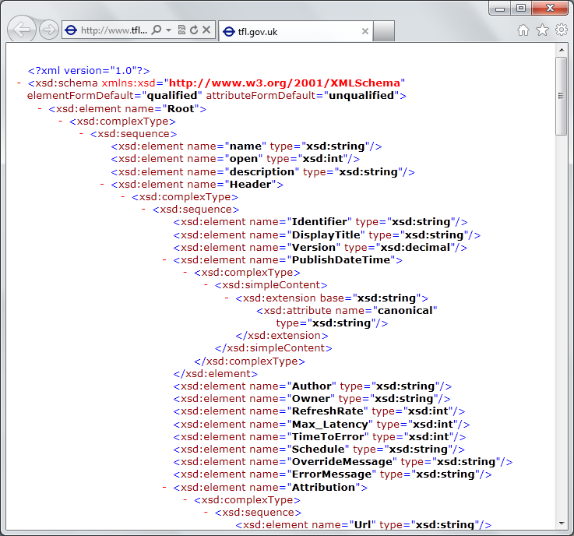
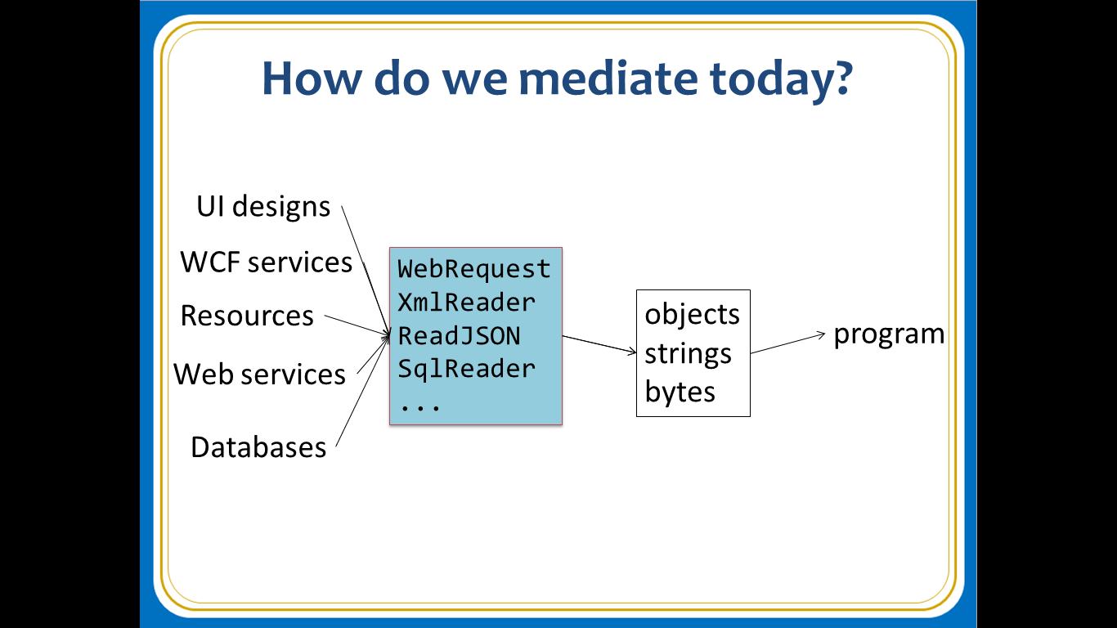
Recap: the problem…
Existing techniques have major problems
Over-reliance on code-generation
Do not scale
No tooling
No strong types
Lowest-common-denominator

Slide 38
Time for a paradigm shift?

Slide 39

Γ $⊢ e$ : τ
The neglected child?

Slide 40

Γ₀ = 0
The great lie!!!

Slide 41
Definition #1 Information-rich programming is where external schematized information sources are integral to the operation of the programs being constructed. These may be as simple as textual DSLs embedded as strings in the program itself, as familiar as SQL databases, as massive as a service exposing Wikipedia data, or the world-wide-web of HTML documents itself.

Slide 42
Definition #2 A (strongly-typed) information-rich programming language integrates external information sources, where the schema and content of these sources are presented in a (strongly-typed) idiomatic form

Slide 43
Theme #1 Big Data → Big Metadata Strongly typed languages and tooling must have a role here, surely!

Slide 44
Theme #2 Huge Information Spaces can and should be viewed as Software Components example: schema change <-> component versioning <-> source compatibility <-> binary compatibility example: software component engineering <-> information space engineering

Slide 45
Theme #3 Multiple Data Standards with One Simple Mechanism Rich type systems, importing rich metadata where it exists

Slide 46
Theme #4 Measure languages by their effectiveness at working with rich external information spaces Example: queries, JSON, XML, type providers, async…

Slide 47
Theme #5 Programming Type Systems v. Information Space Metadata Synergy or Conflict? Examples: Types, Schema, Constraints, Units of Measure, Security Information, Documentation, Definition Locations, Help , Provenance, Privacy, Ratings, Rankings, Search…

Slide 48
Some Sample Research Questions
Can provided probabilistic metadata be useful for tooling?
Can we design type systems which incorporate schema change policies?
Can we automatically find bugs in provider components?
Can we automatically provide all the data in the enterprise?
Can we plug and play more language logic?
Can we provide and verify richer constraints?
Can security, privacy and provenance annotations be provided?
Can we usefully provide massive quantities of geo data + geo metadata?

Slide 49
Summary The world is information rich, our programming needs to be information-rich too
Big Data → Big Metadata
Information-richness changes how we think about strongly-typed programming languages

Slide 50
Thank you! Questions? www.fsharp.net #fsharp

Slide 51

1985
Mirror on underside of shuttle
SDI experiment: The plan
Big mountain in Hawaii

Slide 52
1985
SDI experiment:
The reality

Slide 53
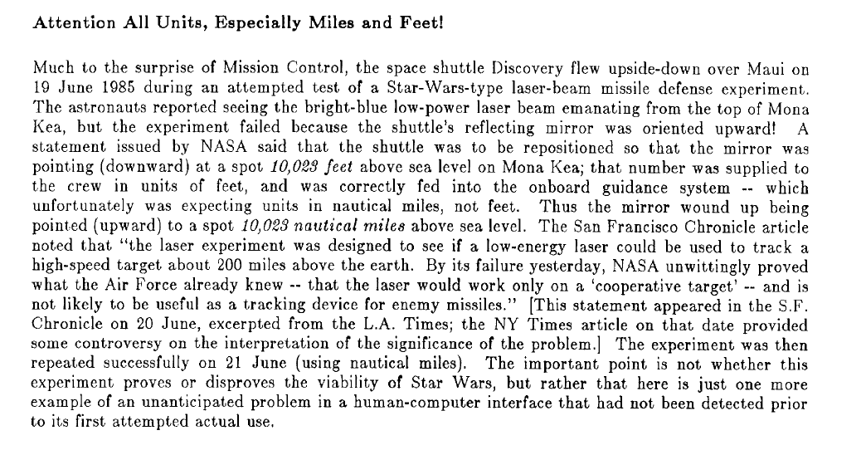
1985

Slide 54
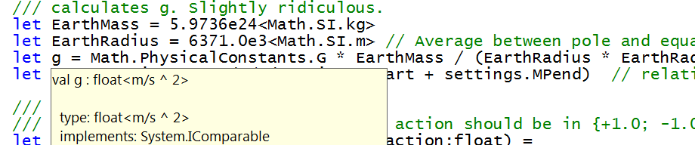
Units of Measure
let EarthMass = 5.9736e24<kg>
// Average between pole and equator radii
let EarthRadius = 6371.0e3<m>
// Gravitational acceleration on surface of Earth
let g = PhysicalConstants.G * EarthMass / (EarthRadius * EarthRadius)

